Slide 1
Vibe Check 2024
CIS 6905 Progress Update – September 6, 2024
Deeptika Kannan

Slide 2
What happened last time
Pulled all comments from YouTube videos of presidential debates performed an initial exploratory data analysis on each dataset
Discussed sources of the comments (i.e., networks) and other potential sources
Discussed duration over which comments have been captured (2020 vs 2024)

Slide 3
What has happened since
Check in with College of Journalism and Communications
Revised word cloud analysis of pulled comment text
Looked into duration over which comments have been collected
Discussed the final goal of producing a real-time dashboard with key indicators

Slide 4
Future Plans
Improved data scraping pipeline, especially for 2024
Use commentThreads() method to iterate and obtain all replies to comments
Preserve and analyze all data scraped, including metadata
Collect video transcripts
Expand video sources for 2020 and 2024 debates
Perform word cloud and additional analysis of pre-election comments in 2020
Explore relationship between likes and comment text
Game plan for September 10 live data scraping?
What are the key indicators?

Slide 5
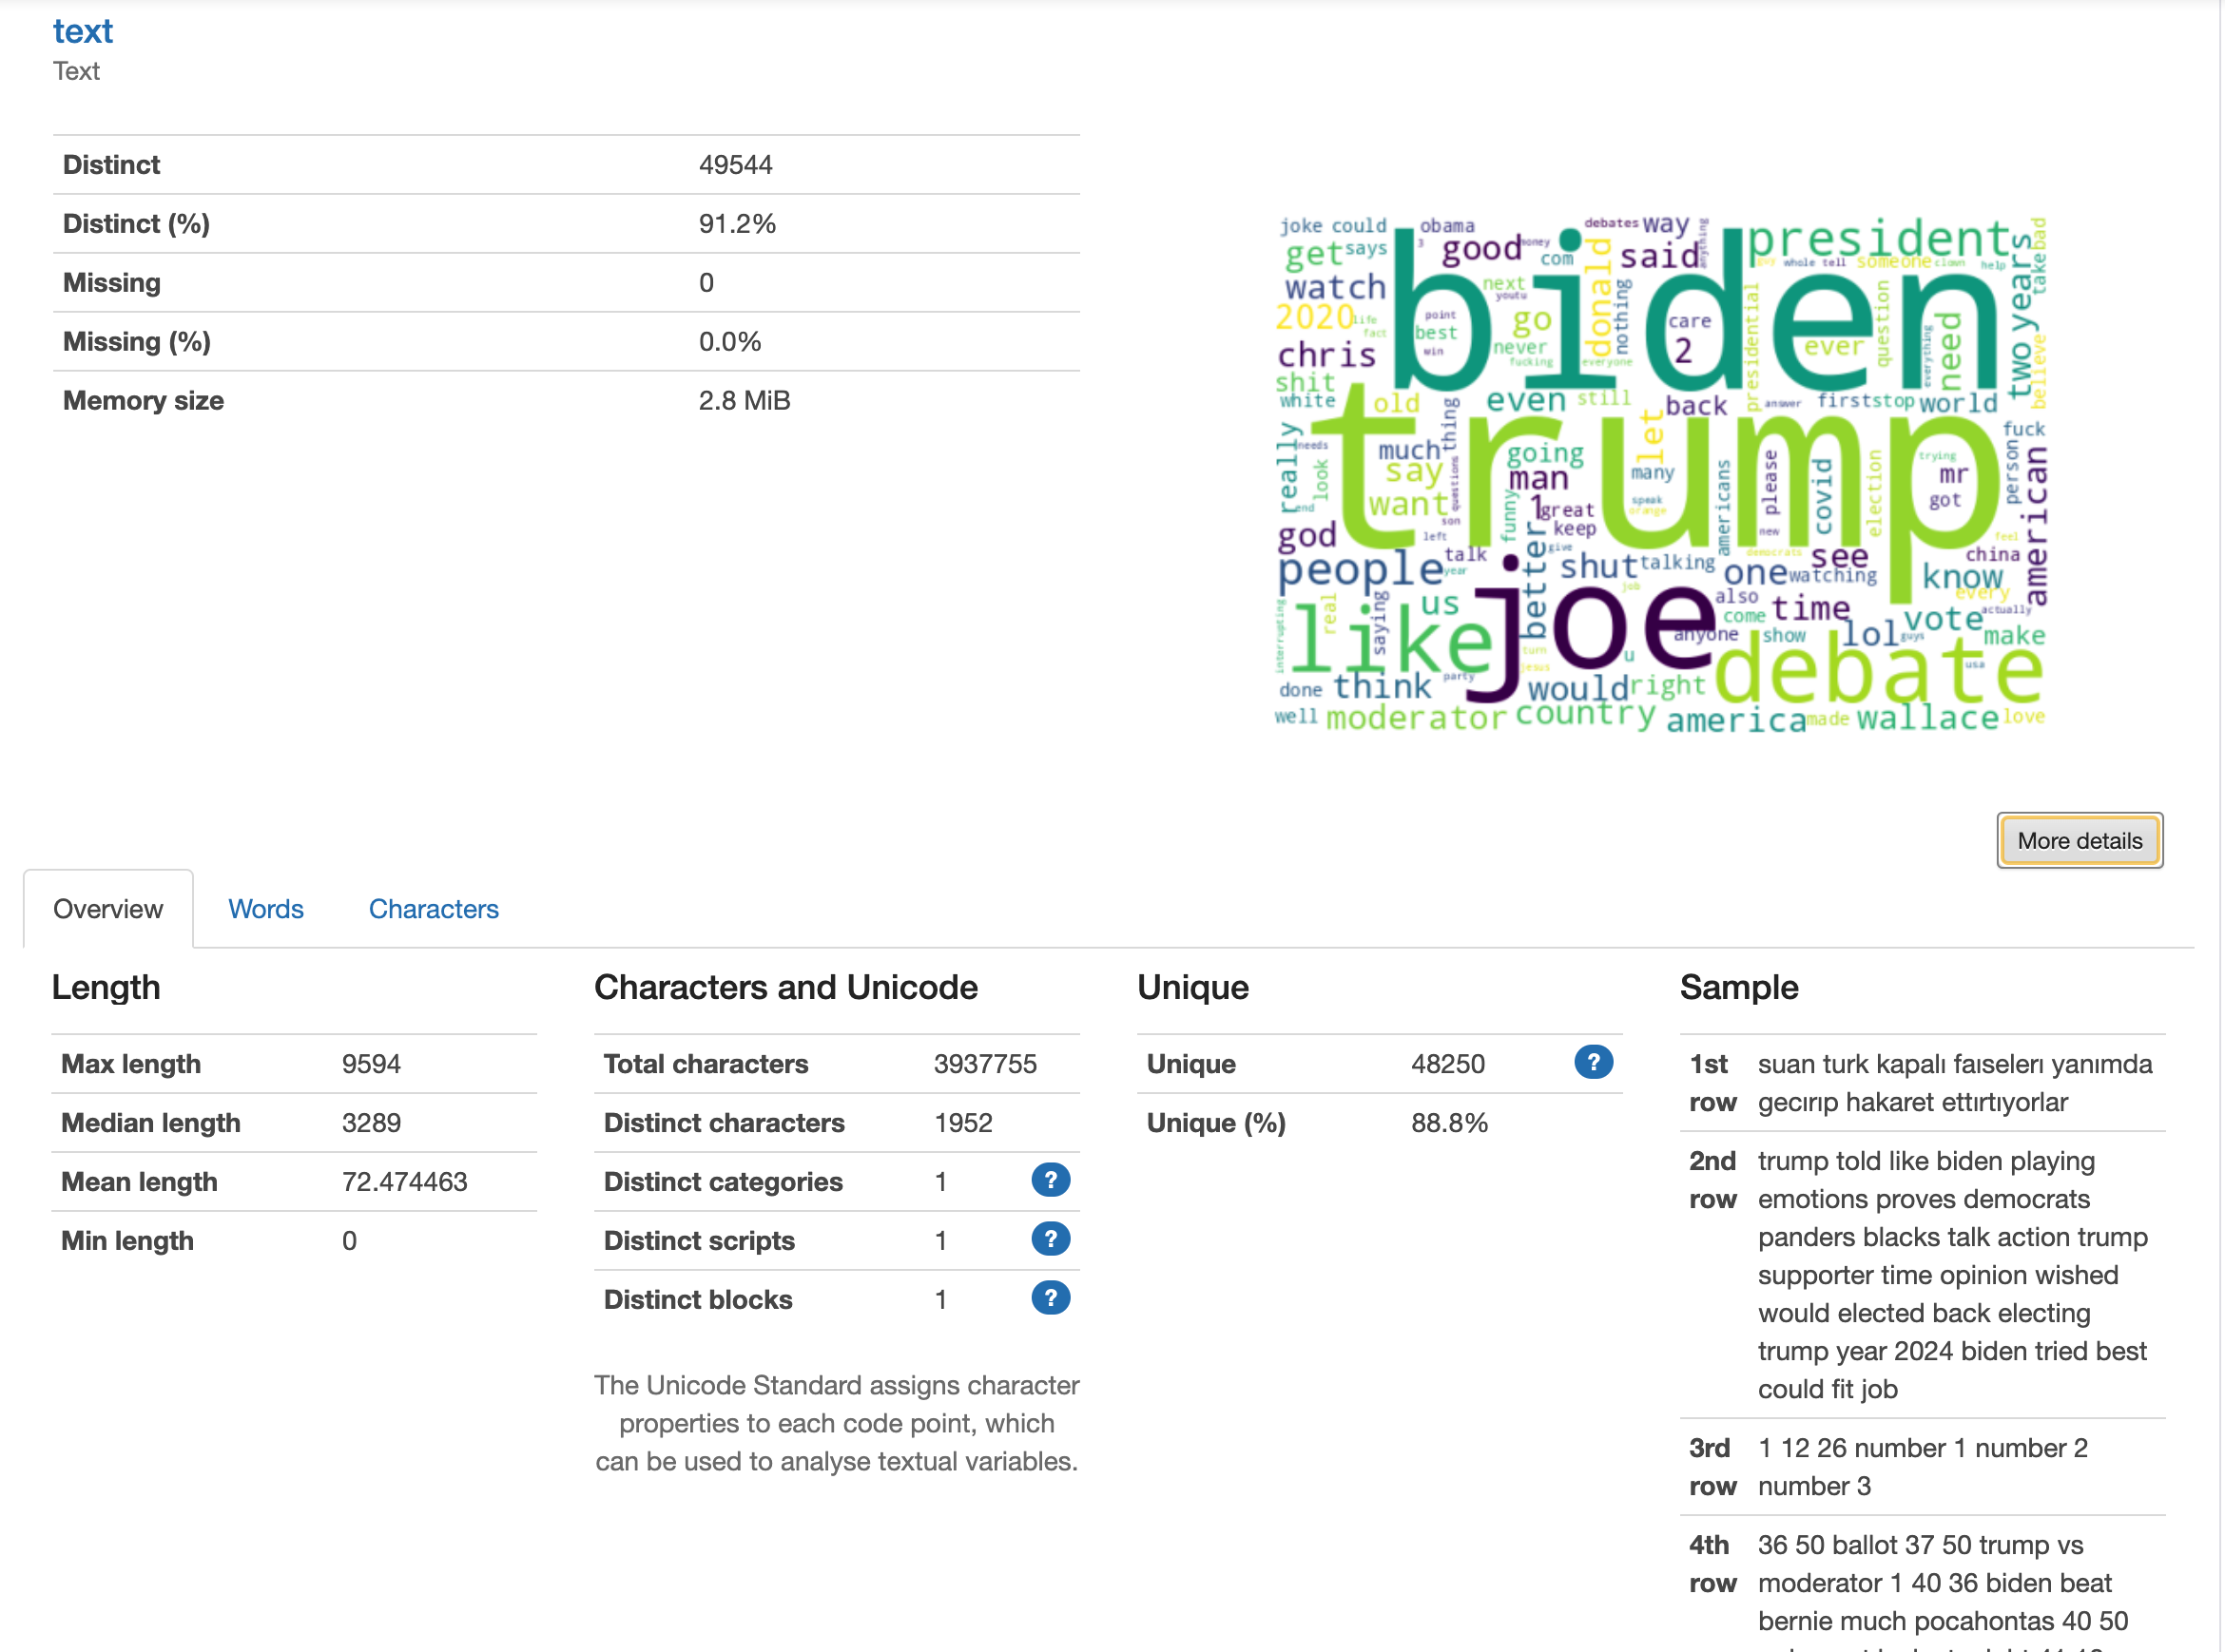
2020 C-SPAN Word Cloud

Slide 6
2024 Wall Street Journal Word Cloud

Slide 7
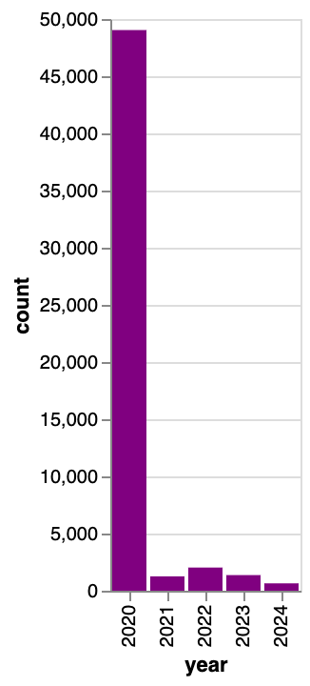
2020: Time period of data collection
Comments over 2020-2024

